Slide 1

How computers communicate?

Slide 2

Data communications play an important role for people, organizations, companies, governments from all over the world

Slide 3

TCP/IP protocol

Slide 4
TCP/IP protocol
Application layer
Telnet
FTP
SMTP
DNS
RIP
SNMP
Transport layer
TCP
UDP
Network layer
IP
ARP
ICMP
IGMP
Link layer
Ethernet
Token Ring
Frame Relay

Slide 5
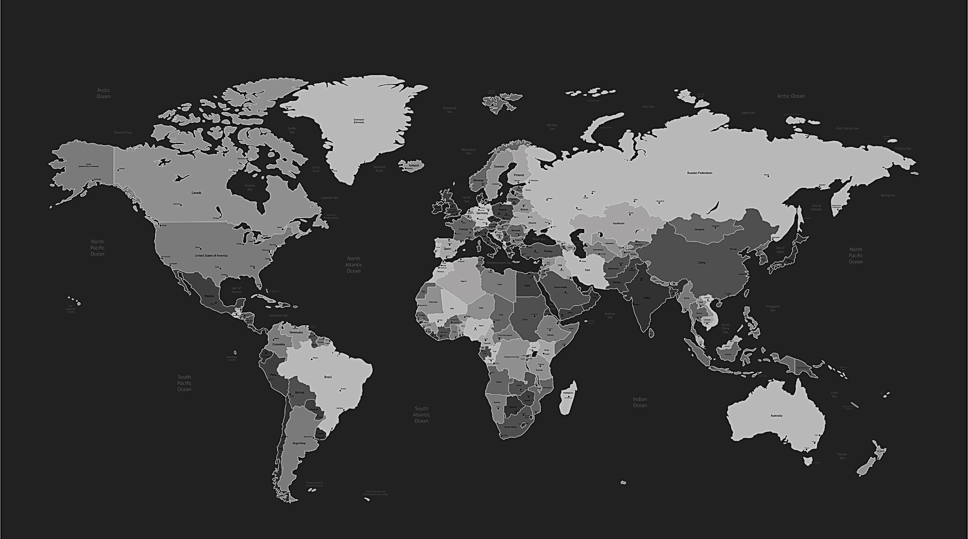

C:\WINDOWS\system32>tracert washington.edu
Tracing route to washington.edu [128.95.155.198] over a maximum of 30 hops:

Slide 6
C:\WINDOWS\system32>tracert washington.edu
Tracing route to washington.edu [128.95.155.198] over a maximum of 30 hops:
1 2 ms 2 ms 2 ms DLINK-1521 [10.10.10.1]

Slide 7
C:\WINDOWS\system32>tracert washington.edu
Tracing route to washington.edu [128.95.155.198] over a maximum of 30 hops:
1 2 ms 2 ms 2 ms DLINK-1521 [10.10.10.1]
2 2 ms 2 ms 5 ms 10.1.1.1

Slide 8
Tracing route to washington.edu [128.95.155.198] over a maximum of 30 hops:
1 2 ms 2 ms 2 ms DLINK-1521 [10.10.10.1]
2 2 ms 2 ms 5 ms 10.1.1.1
3 3 ms 3 ms 5 ms 172-0-1-1.lightspeed.brhmal.sbcglobal.net [172.0.1.1]

Slide 9
Tracing route to washington.edu [128.95.155.198] over a maximum of 30 hops:
1 2 ms 2 ms 2 ms DLINK-1521 [10.10.10.1]
2 2 ms 2 ms 5 ms 10.1.1.1
3 3 ms 3 ms 5 ms 172-0-1-1.lightspeed.brhmal.sbcglobal.net [172.0.1.1]
4 3 ms 2 ms 3 ms 194.85.161.1

Slide 10
1 2 ms 2 ms 2 ms DLINK-1521 [10.10.10.1]
2 2 ms 2 ms 5 ms 10.1.1.1
3 3 ms 3 ms 5 ms 172-0-1-1.lightspeed.brhmal.sbcglobal.net [172.0.1.1]
4 3 ms 2 ms 3 ms 194.85.161.1
5 3 ms 2 ms 2 ms s14-1-gw.spb.runnet.ru [194.85.36.153]

Slide 11
2 2 ms 2 ms 5 ms 10.1.1.1
3 3 ms 3 ms 5 ms 172-0-1-1.lightspeed.brhmal.sbcglobal.net [172.0.1.1]
4 3 ms 2 ms 3 ms 194.85.161.1
5 3 ms 2 ms 2 ms s14-1-gw.spb.runnet.ru [194.85.36.153]
6 3 ms 2 ms 2 ms b57-1-gw.spb.runnet.ru [194.85.40.89]

Slide 12
3 3 ms 3 ms 5 ms 172-0-1-1.lightspeed.brhmal.sbcglobal.net [172.0.1.1]
4 3 ms 2 ms 3 ms 194.85.161.1
5 3 ms 2 ms 2 ms s14-1-gw.spb.runnet.ru [194.85.36.153]
6 3 ms 2 ms 2 ms b57-1-gw.spb.runnet.ru [194.85.40.89]
7 16 ms 17 ms 14 ms xe-5-0-3.bar1.Stockholm1.Level3.net [213.242.110.197]

Slide 13
4 3 ms 2 ms 3 ms 194.85.161.1
5 3 ms 2 ms 2 ms s14-1-gw.spb.runnet.ru [194.85.36.153]
6 3 ms 2 ms 2 ms b57-1-gw.spb.runnet.ru [194.85.40.89]
7 16 ms 17 ms 14 ms xe-5-0-3.bar1.Stockholm1.Level3.net [213.242.110.197]
8 198 ms 199 ms 198 ms vl-3606.car2.Seattle1.Level3.net [4.69.208.137]

Slide 14
5 3 ms 2 ms 2 ms s14-1-gw.spb.runnet.ru [194.85.36.153]
6 3 ms 2 ms 2 ms b57-1-gw.spb.runnet.ru [194.85.40.89]
7 16 ms 17 ms 14 ms xe-5-0-3.bar1.Stockholm1.Level3.net [213.242.110.197]
8 198 ms 199 ms 198 ms vl-3606.car2.Seattle1.Level3.net [4.69.208.137]
9 198 ms 198 ms 198 ms PACIFIC-NOR.car2.Seattle1.Level3.net [4.53.146.142]

Slide 15
6 3 ms 2 ms 2 ms b57-1-gw.spb.runnet.ru [194.85.40.89].
7 16 ms 17 ms 14 ms xe-5-0-3.bar1.Stockholm1.Level3.net [213.242.110.197]
8 198 ms 199 ms 198 ms vl-3606.car2.Seattle1.Level3.net [4.69.208.137]
9 198 ms 198 ms 198 ms PACIFIC-NOR.car2.Seattle1.Level3.net [4.53.146.142]
10 197 ms 197 ms 199 ms ae0--4010.icar-sttl1-2.infra.pnw-gigapop.net [209.124.188.134]

Slide 16
8 198 ms 199 ms 198 ms vl-3606.car2.Seattle1.Level3.net [4.69.208.137]
9 198 ms 198 ms 198 ms PACIFIC-NOR.car2.Seattle1.Level3.net [4.53.146.142]
10 197 ms 197 ms 199 ms ae0--4010.icar-sttl1-2.infra.pnw-gigapop.net [209.124.188.134]
11 201 ms 201 ms 200 ms ae0--4010.uwbr-atg-1.infra.washington.edu [209.124.188.135]

Slide 17
9 198 ms 198 ms 198 ms PACIFIC-NOR.car2.Seattle1.Level3.net [4.53.146.142]
10 197 ms 197 ms 199 ms ae0--4010.icar-sttl1-2.infra.pnw-gigapop.net [209.124.188.134]
11 201 ms 201 ms 200 ms ae0--4010.uwbr-atg-1.infra.washington.edu [209.124.188.135]
12 219 ms 206 ms 207 ms ae3--836.uwar-uwtc-1.infra.washington.edu [128.95.155.195]

Slide 18
10 197 ms 197 ms 199 ms ae0--4010.icar-sttl1-2.infra.pnw-gigapop.net [209.124.188.134]
11 201 ms 201 ms 200 ms ae0--4010.uwbr-atg-1.infra.washington.edu [209.124.188.135]
12 219 ms 206 ms 207 ms ae3--836.uwar-uwtc-1.infra.washington.edu [128.95.155.195]
13 205 ms 235 ms 220 ms www4.cac.washington.edu [128.95.155.198]
Trace complete.

Slide 19
11 201 ms 201 ms 200 ms ae0--4010.uwbr-atg-1.infra.washington.edu [209.124.188.135]
12 219 ms 206 ms 207 ms ae3--836.uwar-uwtc-1.infra.washington.edu [128.95.155.195]
13 205 ms 235 ms 220 ms www4.cac.washington.edu [128.95.155.198]
Trace complete.

Slide 20
How it can be faster?
New technologies
Fiber optics
Laser technologies
Mobile broadband (better than 4G)
Modified protocols
Better routing tables
More simultaneous connections

